Slide 1

IoT-Based Air Pollution Monitoring System for Real-Time Environmental Surveillance
NAME: DIYA AGGARWAL
EMAIL: diyaaggarwal1809@gmail.com

Slide 2
Introduction
Weather monitoring and Controlling Air Quality Index(AQI) are vital for keeping our air clean and people healthy.
AQI monitoring checks for pollutants like ozone, carbon dioxide, carbon monoxide in the air we breathe.
By tracking weather and AQI, we can take steps to reduce pollution and keep our air safe for everyone.
Weather monitoring helps us understand what’s happening in the atmosphere like Temperature, wind, and Humidity.
This introduction emphasizes the importance of watching the weather the weather and controlling AQI to protect our health and environment.

Slide 3
Problem Definition:
In recent years, the deterioration of air quality has become a critical issue globally, impacting public health, environmental sustainability, and quality of life. To address this challenge effectively, there is a pressing need for a robust air quality monitoring system that provides accurate, real-time data on air pollution levels.
Lack of Comprehensive Monitoring: Existing air quality monitoring systems often lack comprehensive coverage, leaving certain areas underserved or poorly monitored. This leads to gaps in data collection and an incomplete understanding of air pollution patterns.
Inaccurate Data: Many current monitoring systems utilize outdated technology or insufficient monitoring stations, resulting in inaccurate data. This compromises the reliability of air quality assessments and hinders effective decision-making for pollution control measures.
Limited Accessibility: Accessibility to air quality data is often restricted, making it challenging for policymakers, researchers, and the public to access timely and relevant information. This impedes efforts to raise awareness, implement targeted interventions, and foster community engagement in addressing air pollution.

Slide 4
Literature Survey:
Somansh & Ashish (2017) proposed real-time standalone air quality monitoring system using IoT. The measured data has compared with ground station data located in Delhi and displayed in Dashboard created using Arduino.
Phala et al (2016) were presented an air quality monitoring system (AQMS) which is based on the IEEE/ISO/IEC 21451 standard. Concentrations of CO, CO2, SO2 and NO2, were measured using electrochemical and infrared sensors.
Balasubramaniyan et al., (2016) proposed Sensor web node with commercial gas sensors for detecting the gases like CO, CO2, NH3 and NOx to monitor both indoor and outdoor air quality. The observed results are properly evaluated using Thing Speak open source IoT platform.

Slide 5
Objective:
To Install High Efficiency Particulate Air (HEPA) filters in strategic locations within the target area.
Integrate water sprayers or misting systems along with the HEPA filter units. Water sprayers help in controlling larger particles and can also mitigate certain gaseous pollutants by promoting their dissolution into water droplets.
To Interface the air quality sensors with the Arduino board to collect real-time measurements of pollutant concentrations.
Implement data analytics algorithms to analyze air quality trends, detect pollution spikes, and identify potential sources of contamination. Generate visualizations and reports to present actionable insights to stakeholders.
Set up a cloud-based IoT platform (e.g., AWS IoT, Azure IoT, Google Cloud IoT) to receive and store sensor data in a centralized database.

Slide 6
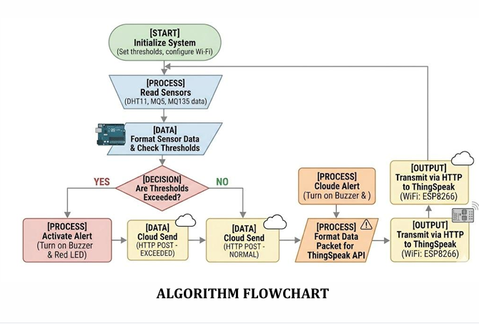
Methodology:
Design of Air Quality Control System:
a. HEPA Filter Installation:
Install High Efficiency Particulate Air (HEPA) filters in strategic locations within the target area.
HEPA filters are capable of capturing particles as small as 0.3 microns with high efficiency,
including dust, pollen, smoke, and other airborne pollutants.
b. Water Sprayer Installation:
Integrate water sprayers or misting systems along with the HEPA filter units.
Water sprayers help in controlling larger particles and can also mitigate certain gaseous pollutants by promoting their dissolution into water droplets.

Slide 7
2. Placement of Control Units: Determine optimal locations for placing HEPA filter units and water sprayers based on air flow patterns, pollution hotspots, and population density. Ensure coverage of key areas such as residential neighborhoods, industrial zones, and commercial districts.
3. Identification of Pollution Sources: Conduct a thorough assessment to identify the primary sources of air pollution in the target area, including industrial emissions, vehicular exhaust, biomass burning, and other sources.
4. Establish mechanisms for continuous evaluation and improvement of the air quality control system. Monitor system performance, gather feedback from stakeholders, and incorporate technological advancements or best practices to enhance overall effectiveness and efficiency.

Slide 8
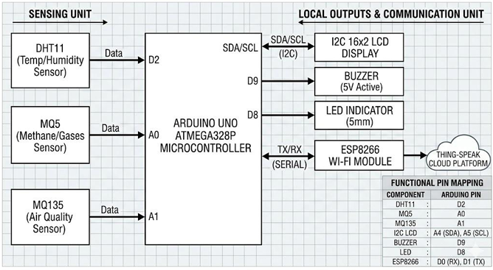
Hardware System Architecture

Slide 9
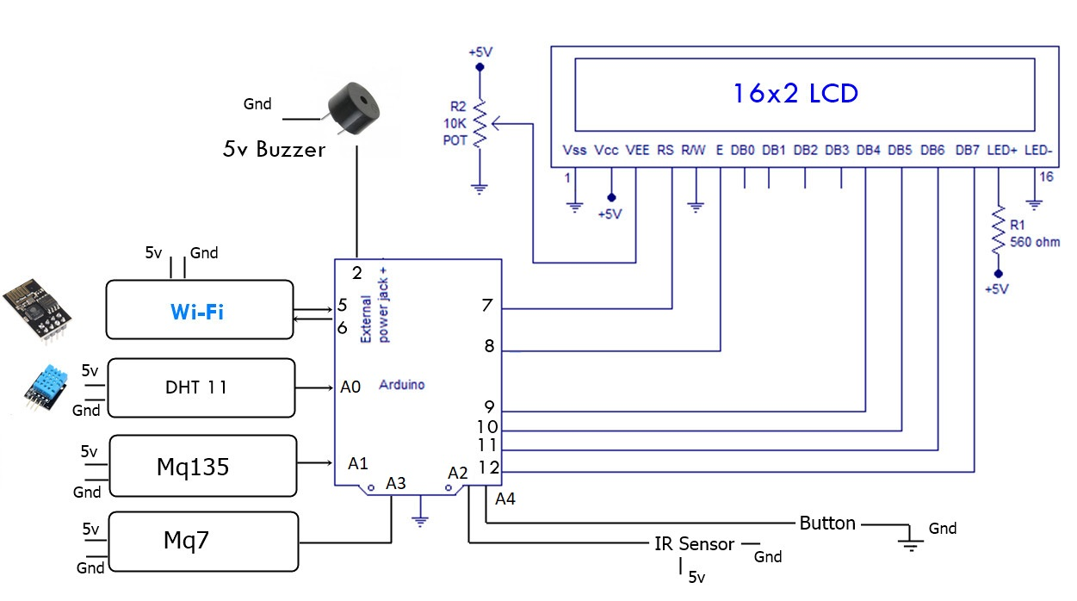
Block Diagram

Slide 10
Hardware Description:
Arduino uno: Arduino uno is a microcontroller board developed by Arduino which is an open source electronics platform it is easy to available and can be used easily. The Board Contains 14 Digital Input Output pins in which 6 are Analog pins, USB Connector, one Reset Button, and other Components.
DHT11: the DHT11 gives digital output. It is an extremely low cost, low power, ultra- small digital temperature and humidity sensor. Operating voltage: 3.5v-5.5v, operating current: 0.3mA.
MQ135: MQ135 is an air quality sensor that detects a wide variety of gases like Ammonia (NH3), Nitrogen oxide (NO2), Alcohol, Smoke, Carbon dioxide etc. it MQ135 Module operates at 5v and consumes around 150mA.
MQ5: MQ-5 is a gas sensor used to detect LPG, Methane, Propane, and Natural gas. It is commonly used in gas leakage detection systems. The sensor provides both analog and digital outputs. Operating voltage: 5V, Preheat time required for accurate readings.
Dust Sensor: A dust sensor is used to detect particulate matter such as dust and smoke in the air. It works on the principle of light scattering to measure particle concentration. It is useful for monitoring air pollution levels and indoor air quality. Operating voltage: typically 5V (varies by model), Provides analog output based on dust concentration.
Arduino Uno

Slide 11
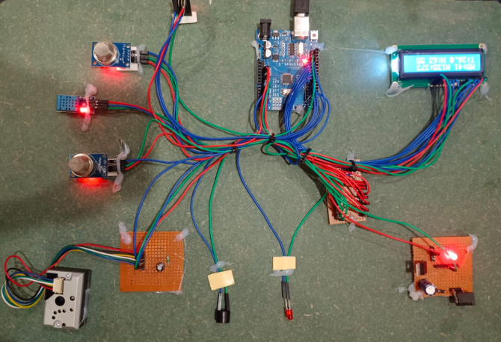
Hardware Design – Circuit Diagram

Slide 12
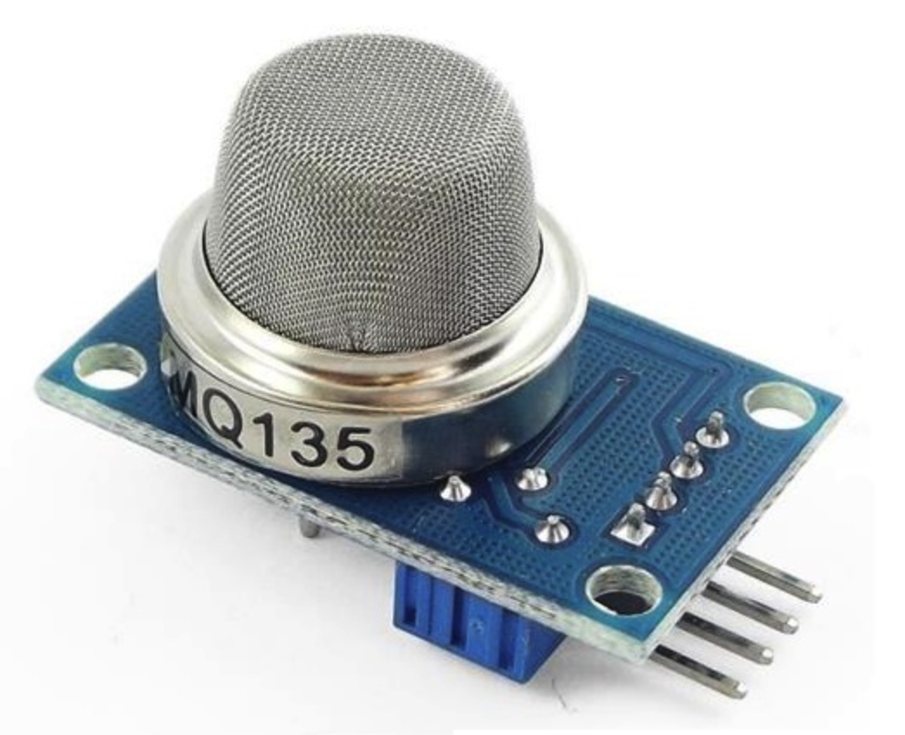
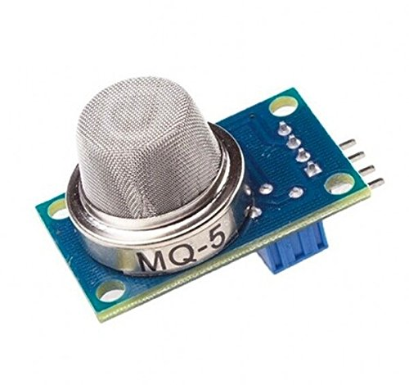
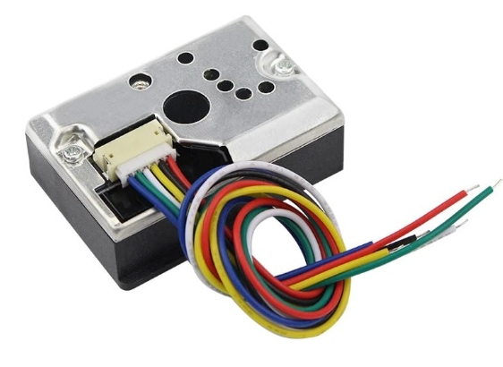
Modules Used – Sensors
MQ -135:
Sensor for detecting General Air Quality
MQ-5:
Sensor for detecting Carbon Monoxide
Dust sensor:
They detect dust/PM2.5 particles in air using light scattering

Slide 13
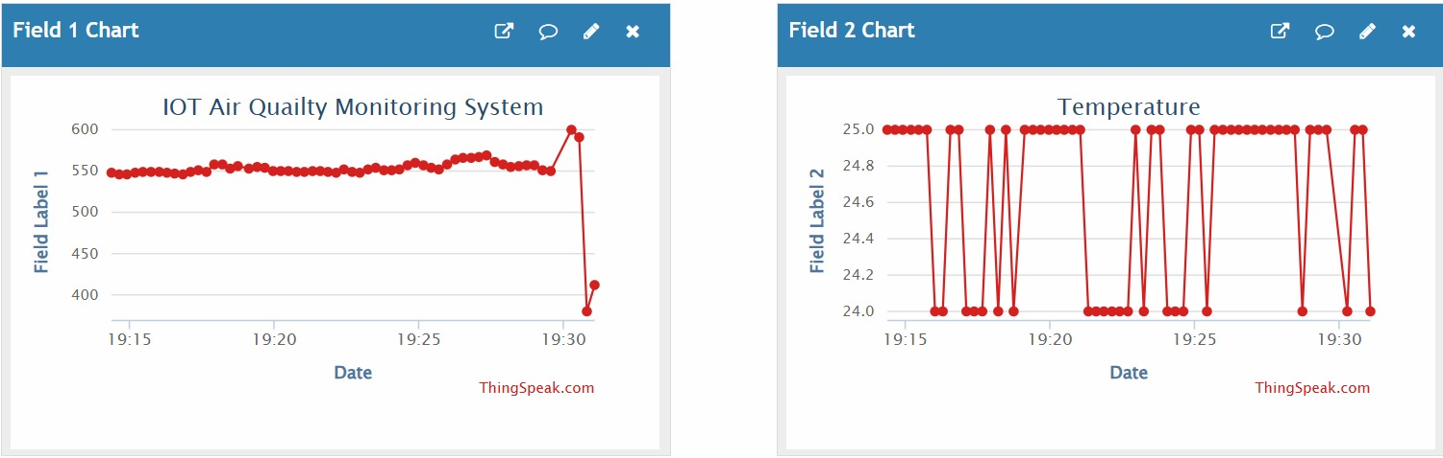
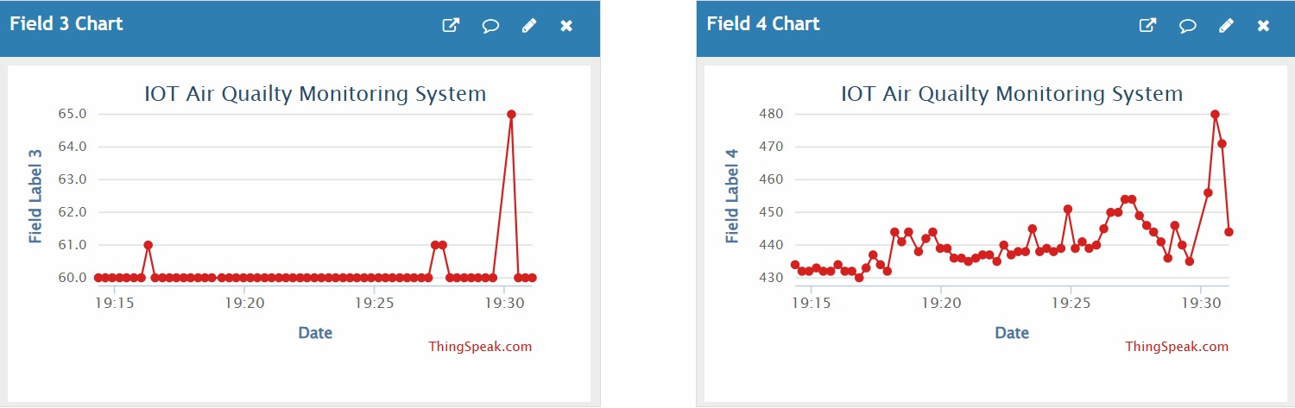
Results
A. System Operation
The system was tested under real-time conditions to validate its functionality. Upon power-on, the system performs the following sequence:
Initializes sensor modules and establishes Wi-Fi connectivity
Connects to the local network via mobile hotspot
Authenticates with the ThingSpeak platform
Begins continuous data acquisition and transmission
B. Data Visualization
The ThingSpeak dashboard displays four graphical plots representing:
Methane concentration (ppm) versus time
Carbon monoxide and ethanol concentration (ppm) versus time
Ammonia concentration (ppm) versus time
Temperature (°C) and humidity (%) versus time
The system also supports geolocation tagging by specifying latitude and longitude coordinates, enabling location-specific data presentation.

Slide 14
C. Performance Analysis
Experimental results demonstrate:
Reliable sensor data acquisition with consistent readings
Stable Wi-Fi connectivity and successful data transmission
Real-time visualization with minimal latency
Effective alert triggering when threshold values are exceeded
The graphical plots clearly show variations in environmental parameters over time, enabling users to identify trends and anomalies in air quality conditions.
D. Alert Mechanism Validation
The alert system was tested by exposing sensors to elevated gas concentrations. When pollutant levels exceeded predefined thresholds, the buzzer activated and LED indicators illuminated, providing immediate user notification.

Slide 15
Applications
Air quality Management
Healthcare
Agriculture
Industrial operations
Outdoor Activities
Public Awareness and Education

Slide 16
Conclusions
Developed IoT-based air pollution monitoring system
Monitors temperature, humidity & harmful gases
Provides real-time air quality data
Enables remote monitoring via internet (Wi-Fi)
Includes alert system (buzzer & LED) for safety
Cost-effective, eco-friendly & easy to deploy
Suitable for indoor & outdoor environments
Helps improve public health awareness

Slide 17
References
1. Han, Y., Cheng, X., Han, J., & Zeng, X. (2020). Radiation-Hardened 0.3-0.9-V Voltage-Scalable 14T SRAM and Peripheral Circuit in 28-nm Technology for Space Applications. IEEE Transactions on Very Large-Scale Integration (VLSI) Systems, 1–5. doi:10.1109/tvlsi.2019.2961736
2. Lin, Zhi-Ting & Wu, Xiulong& Li, Zhi & Guan, Lijun & Peng, Chunyu& Liu, Changyong& Chen, Junning. (2016). A Pipeline Replica Bitline Technique for Suppressing Timing Variation of SRAM Sense Amplifiers in a 28-nm CMOS Process. IEEE Journal of Solid-State Circuits. PP. 1-9. 10.1109/JSSC.2016.2634701.
3. Chang, M. F., Chen, M. P., Chen, L. F., Yang, S. M., Kuo, Y. J., Wu, J. J., & Yamauchi, H. (2013). A Sub-0.3 V Area-Efficient L-Shaped 7T SRAM With Read Bitline Swing Expansion Schemes Based on Boosted Read-Bitline, Read-Port, and Offset Cell VDD Biasing Techniques. IEEE journal of solid-state circuits, 48(10), 2558-2569..
4. C. Peng et al., (2019) “Radiation-hardened 14T SRAM bitcell with speed and power optimized for space application,” IEEE Trans. Very Large Scale Integr. (VLSI) Syst., vol. 27, no. 2, pp. 407–415.
5. Peng, C., Tao, Y., Lu, W., Li, Z., Ji, X., Yan, J., & Chen, J. (2015). A novel cascade control replica-bitline delay technique for reducing timing process-variation of SRAM sense amplifier. IEICE Electronics Express, 12-20150102.
6. Atias, L., Teman, A., Giterman, R., Meinerzhagen, P., & Fish, A. (2016). A low-voltage radiation-hardened 13T SRAM bitcell for ultralow power space applications. IEEE Transactions on Very Large Scale Integration (VLSI) Systems, 24(8), 2622-2633.

Slide 18
7. Saiz-Adalid, L. J., Reviriego, P., Gil, P., Pontarelli, S., & Maestro, J. A. (2014). MCU tolerance in SRAMs through low-redundancy triple adjacent error correction. IEEE Transactions on Very Large Scale Integration (VLSI) Systems, 23(10), 2332-2336.
8. Kumar, C. I., & Anand, B. (2018). Design of highly reliable energy-efficient SEU tolerant 10T SRAM cell. Electronics Letters, 54(25), 1423-1424.
9. L. D. T. Dang, D. Seo, J.-W. Han, J. Kim, and I.-J. Chang, (2018) “A 28 mn FD-SOI 4KB radiation-hardened 12T SRAM macro with 0.6 _ 1V wide dynamic voltage scaling for space applications,” in Proc. IEEE Asianc Solid-State Circuits Conf. (A-SSCC), pp. 133–134.
10. Lin, S., Kim, Y. B., Lombardi, F., & Lee, Y. J. (2008, November). A new SRAM cell design using CNTFETs. In 2008 International SoC Design Conference (Vol. 1, pp. I-168). IEEE.
11. N. N. Mahatmeet al., (2013) “Impact of supply voltage and frequency on the soft error rate of logic circuits,” IEEE Trans. Nucl. Sci., vol. 60, no. 6, pp. 4200–4206.
12. Guo, J., Zhu, L., Sun, Y., et al.: (2018) ‘Design of area-efficient and highly reliable RHBD 10T memory cell for aerospace applications’, Trans. Very Large Scale Integr. Syst.,26, (5), pp. 991–994
13. Qi, C., Xiao, L., Wang, T., et al. (2016) ‘A highly reliable memory celldesign combined with layout-level approach to tolerant single-eventupsets’, Trans. Device Mater. Reliable., 16, (3), pp. 388–395.
14.A. Yan, Z. Huang, M. Yi, X. Xu, Y. Ouyang, and H. Liang, (2017)“Doublenode-upset-resilient latch design for nanoscale CMOS technology,”IEEE Trans. Very Large Scale Integr. (VLSI) Syst., vol. 25, no. 6,pp. 1978–1982.

Slide 19
Thank You

